Slide 1
Data-Driven Decision Making
Improves Organizational Confidence
in Business Strategies
Source: 🔗 Link: https://www.mckinsey.com/capabilities/quantumblack/our-insights/the-age-of-analytics-competing-in-a-data-driven-world
Mckinsey and company Industry
Henke, N., Bughin, J., Chui, M., Manyika, J., Saleh, T., Wiseman, B., & Sethupathy, G.
1000+ Companies
18 Variables
3 Analytics Types

Slide 2
Problem Statement
"Data-driven decision making improves organizational confidence in business strategies"
The Gap
The Question
The Need
Many organizations rely on intuition over data, creating strategic uncertainty and inconsistent decision quality.
Does adopting data-driven practices measurably increase confidence in business strategy?
Quantitative evidence is needed to justify investment in data tools, infrastructure, and training programs.

Slide 3
Research Objectives
Measure the Relationship
Test Statistical Significance
01
02
Quantify the correlation between data maturity and confidence using Pearson correlation & regression (r = +0.954, R² = 91%).
Apply ANOVA and t-tests to confirm observed differences are not due to chance (all results p < 0.001).
Build a Predictive Model
Identify Key Drivers
03
04
Develop and compare 5 ML models: Multiple Linear Regression, Ridge, Decision Tree, Random Forest, Gradient Boosting.
Use feature importance analysis to rank which data-driven factors most strongly predict organizational confidence.

Slide 4
Data Collection
Dataset Source
Key Variables
Constructed following: Kaggle Sample size: 1000+ companies Variables: 18 columns Industries: Technology, Finance, Healthcare, Retail, Manufacturing, Education Sizes: Small, Medium, Large
Data_Maturity_Level
Core predictor (1–5)
Org_Confidence_Score
Outcome variable (0–100%)
BI_Dashboard_Usage_Pct
% managers using BI
Data_Literacy_Score
Staff literacy (1–10)
Real_Time_Data_Access
Binary (Yes / No)
Dedicated_Data_Team
Binary (Yes / No)
KPI_Review_Frequency
Weekly / Monthly / Quarterly
Exec_Data_Training_Hrs
Training hrs per year

Slide 5
Data Preprocessing
01
Encoding
02
Missing Values
03
Train/Test Split
Categorical variables (Industry, Company Size, KPI Frequency) converted to numeric using LabelEncoder for ML models.
No missing values in the dataset. All 1000 rows complete across all 18 variables — confirmed via summary() in R.
Dataset split 80% training 20% testing (80 rows) using createDataPartition() to ensure balanced distribution.
04
Feature Selection
05
Scaling
06
Reproducibility
14 predictor variables selected from 18 columns. Company_ID, Annual_Revenue removed as non-predictive identifiers.
Not required for tree-based models. Applied implicitly for Ridge Regression via glmnet package's internal standardisation.
set.seed(42) applied before all splits and model training to ensure consistent, reproducible results.

Slide 6
Descriptive Analysis
68.5%
3.12
56.3%
14.5d
Mean Org.
Confidence Score
Mean Data
Maturity Level (1–5)
Mean BI Dashboard
Usage
Avg Decision
Time (days)
Key Findings
Level 1 companies: 29.9% confidence
Level 5 companies: 99.3% confidence
+69.4 pt gap across maturity levels
SD = 22.8 — wide variation to explain
Industry has minimal effect on confidence

Slide 7
Inferential Analysis
Test | What Was Tested | Key Result | p-value
Pearson Correlation | Data Maturity vs Confidence | r = +0.954 (very strong +ve) | < 0.001 ***
Simple Regression | Data Maturity → Confidence | R² = 91% | +17.8 pts per level | < 0.001 ***
ANOVA | 5 Maturity Groups | F = 1059 | 29.9% → 99.3% | < 0.001 ***
t-Test | Real-Time Data Access | +38.1 pt gap (91.1% vs 53.0%) | < 0.001 ***
t-Test | Dedicated Data Team | +20.3 pt gap (77.9% vs 57.6%) | < 0.001 ***
ANOVA | KPI Review Frequency | F = 1002 | Weekly 91% vs Quarterly 30% | < 0.001 ***
Multiple Regression | 5 combined predictors | R² = 92.2% | Adj R² = 92.1% | < 0.001 ***

Slide 8
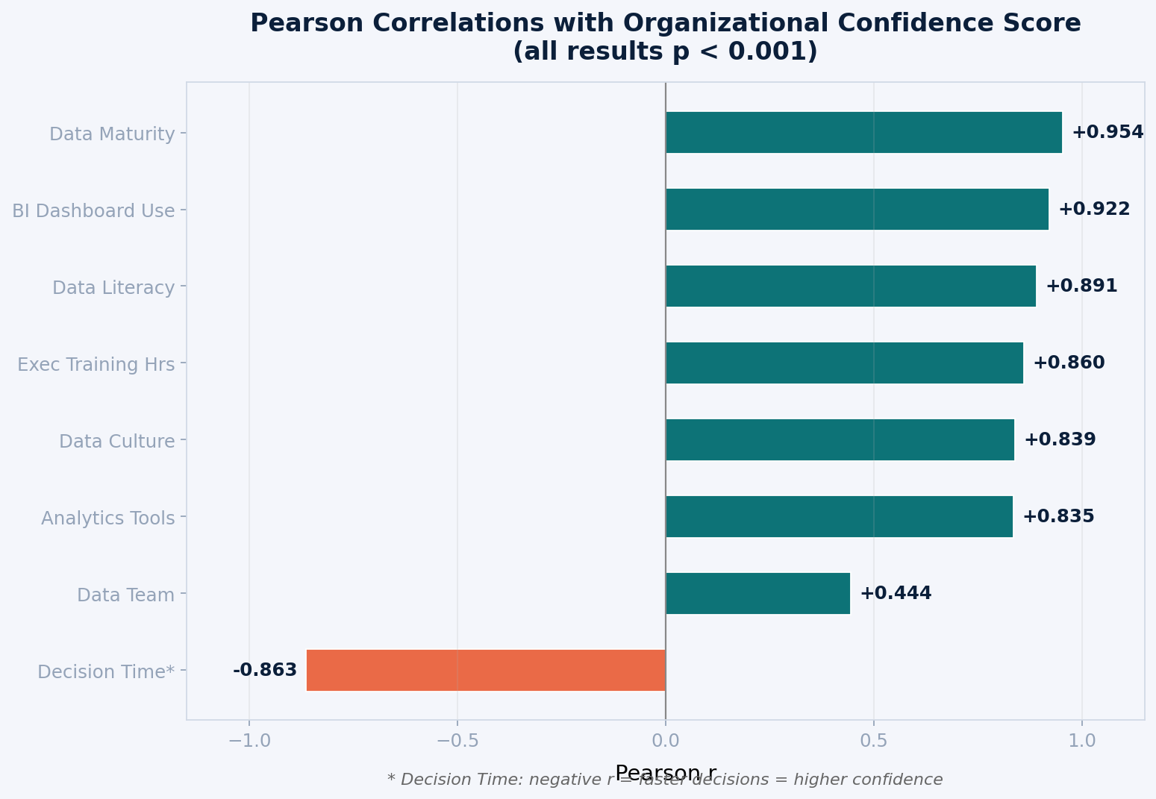
Inferential Analysis

Slide 9
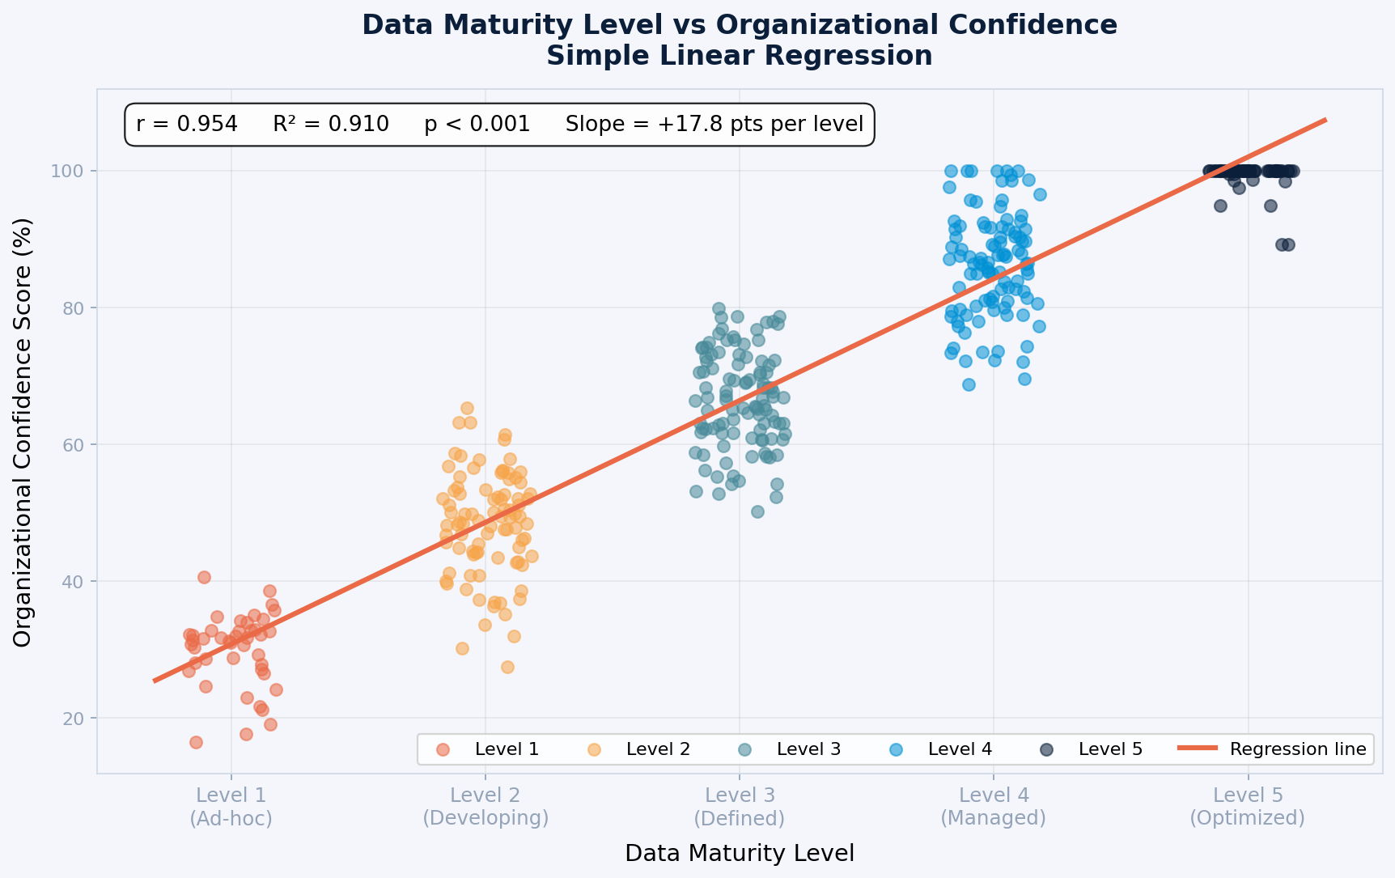
Inferential Analysis

Slide 10
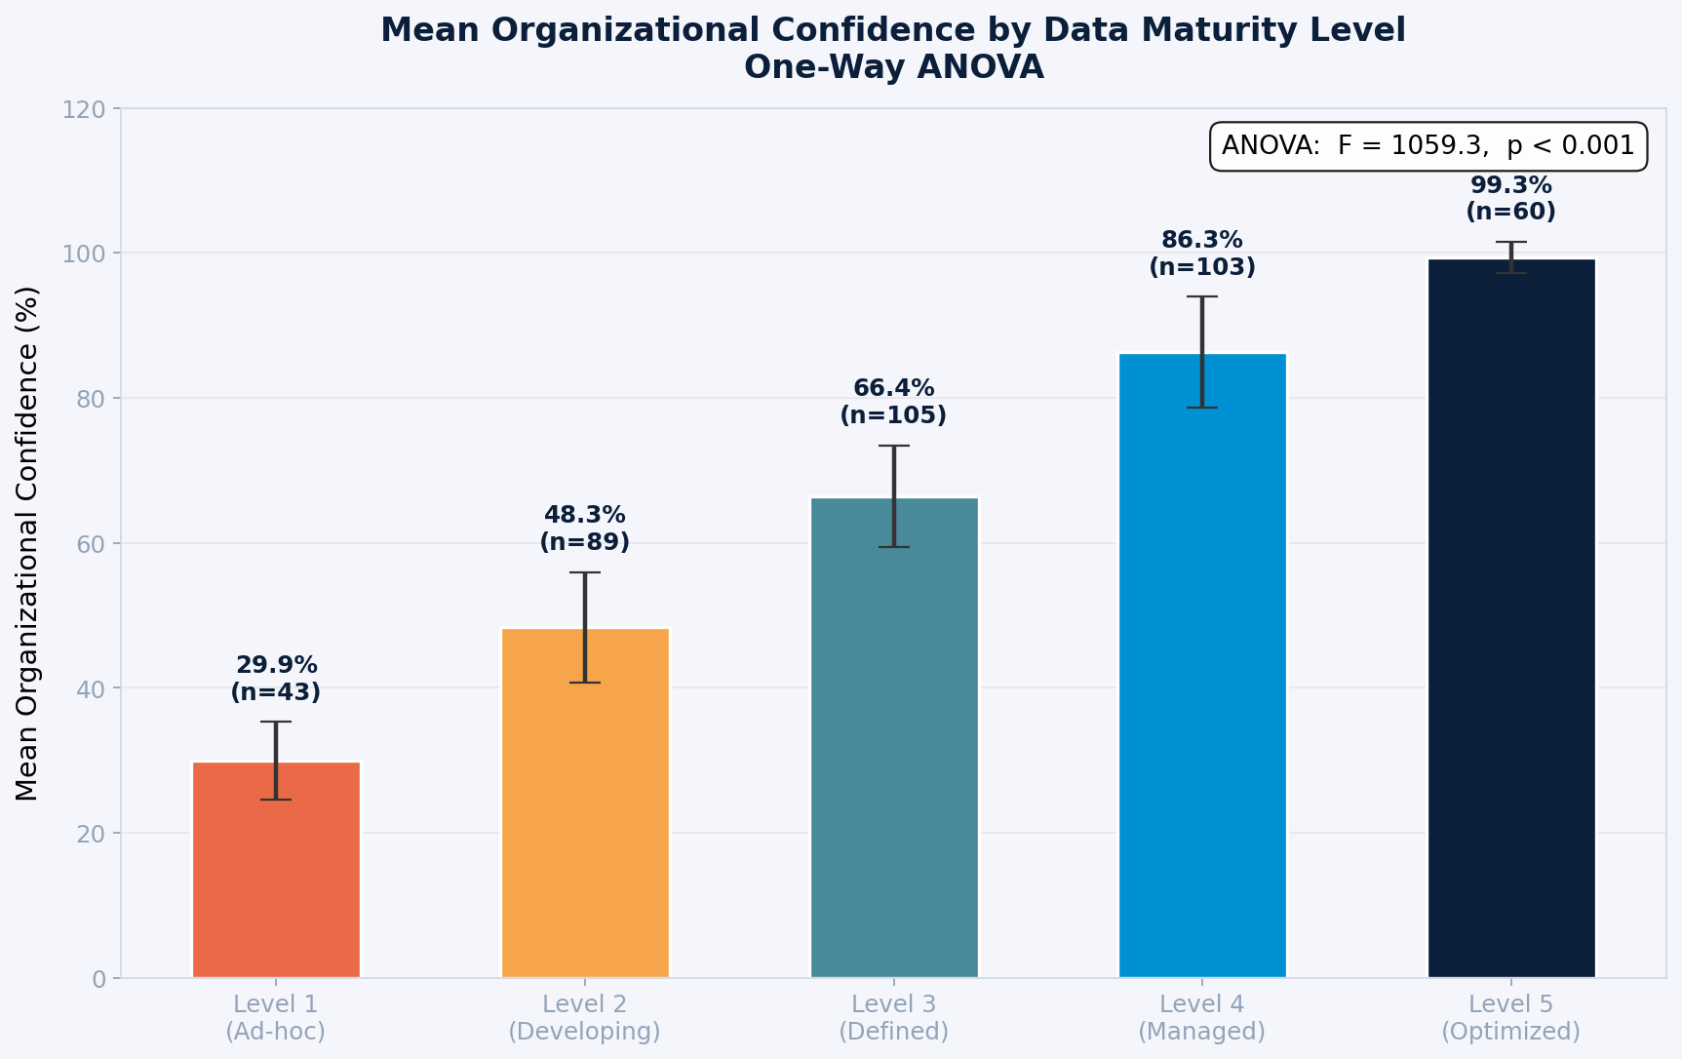
Inferential Analysis

Slide 11
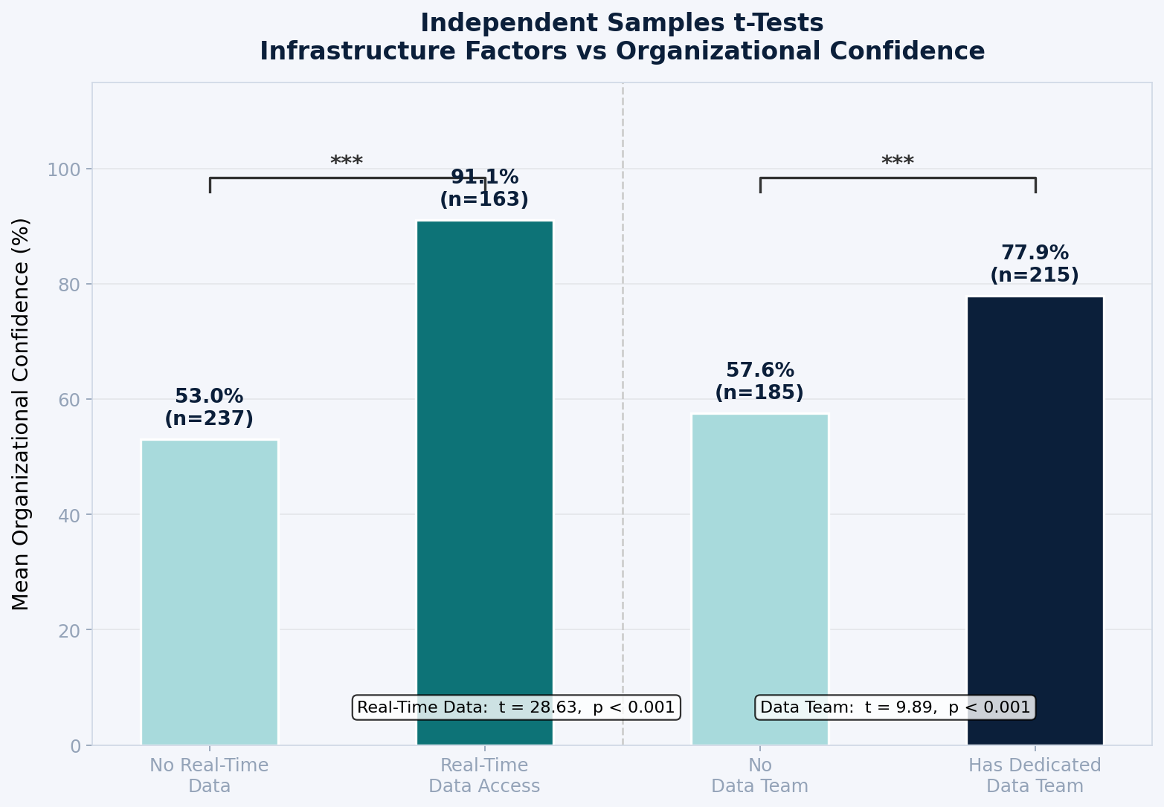
Inferential Analysis

Slide 12
Predictive Model
Recommended Model
Multiple Linear
Regression
Test R² = 0.9114
MAE = 5.41 pts only
No overfitting detected
Full coefficient interpretability
CV R² = 0.9172 ± 0.008
Scenario Predictions (MLR)
Low data company
30.5%
Average company
69.0%
High data company
99.8%

Slide 13
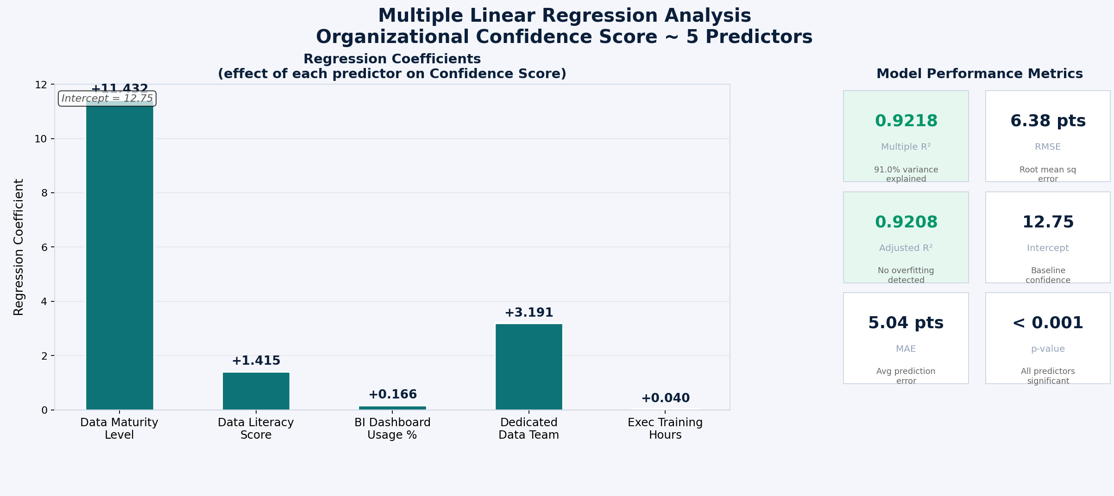
Predictive Model

Slide 14
Results Summary
r = 0.954
R² = 91%
+38 pts
Pearson Correlation
(Data Maturity vs Confidence)
Variance Explained
by Data Maturity Alone
Confidence Gain
with Real-Time Data Access
All 8 Tests Significant
Pearson r: +0.954 ***
Simple Reg R²: 91.0% ***
ANOVA (Maturity): F=1059 ***
t-Test (Real-Time): +38pt ***
t-Test (Data Team): +20pt ***
ANOVA (KPI Freq): F=1002 ***
Multiple Reg R²: 92.2% ***
MLR Test R²: 0.9114 ***

Slide 15
Final Decision
CONFIRMED: Data-driven decision making significantly improves organizational confidence in business strategies
Evidence
Magnitude
Prediction
All 8 statistical tests returned p < 0.001. The relationship is real, consistent, and not due to chance.
Companies at Data Maturity Level 5 score 99.3% confidence vs 29.9% at Level 1 — a 69-point difference.
MLR model predicts confidence with R²=91% and MAE of only 5.4 pts. Scenario forecasting is reliable.
Invest in data maturity, analytics tools, real-time access, and executive training to drive organizational confidence.

